Slide 1
Computer Contracts & Software Liabilities LECTURE # 7

Slide 2
Fair Use Notice
The material used in this presentation i.e., pictures/graphs/text, etc. is solely intended for educational/teaching purpose, offered free of cost to the students for use under special circumstances of Online Education due to COVID-19 Lockdown situation and may include copyrighted material - the use of which may not have been specifically authorized by Copyright Owners. It’s application constitutes Fair Use of any such copyrighted material as provided in globally accepted law of many countries. The contents of presentations are intended only for the attendees of the class being conducted by the presenter.

Slide 3

Contract
A contract is an agreement between two or more persons (the parties to the contract) that can be enforced in a court of law.
The parties may be legal or natural persons.
What is essential:
All the parties must intend to make a contract.
All the parties must be competent to make a contract.
Old enough and sufficiently sound mind to understand what they are doing.
There must be a consideration .
Each party must be receiving and providing something.

Slide 4
Contract law
Largely based on common law
The existing contract law perfectly adequate to handle contracts for the supply of computers, software and associated services.
However, the coming of the internet and e-commerce has created a need for new provisions to deal with matters as :
Electronic signature
Which country’s law should govern transactions when the parties to the transaction are in different countries ?

Slide 5


Fixed Price Contracts For Bespoke System
Tailor-made or bespoke: an organization buys a system configured specifically to meet his needs.
Typically consist of 3 parts:
Agreement
States who the parties are
Stays anything that have been said or agreed before
Signed by the parties
Standard terms and conditions
Schedules or annexes
Used on fairly large contracts
Many small-scale projects are carried out satisfactory using much simpler contracts, often no more than an exchange of letters

Slide 6
What Is To Be Produced?
Contract necessarily states what is to be produced.
Usually two level of reference:
Standard terms and conditions refer to an annex.
The annex then refers to the requirement specification in a separate document
Contract should provide a procedure for requirement specification changes, including:
A method of calculating payment for the changes
Variation of the method of acceptance testing

Slide 7
What Is To Be Delivered?
Non exhaustive list of possibilities:
Source code
Command files (For building the executive from source)
Documentation (of the design and the code)
Manuals
Reference manuals
Training manuals
Operation manuals
Software tools to help maintaining the code
Training
For user
For client’s maintenance staff
Test data and test results

Slide 8
Rights Ownership
Stating what legal rights are being passed form the developer to the client is important.
Ownership in physical items will usually passed.
E.g. books, documents, disks
More than that, software is protected by intellectual rights:
Copyright
Design rights
Confidentiality
trademarks
Contract should state who is to own these rights.

Slide 9
Confidentiality
The two parties may acquire confidential information about each other when a bespoke software is being developed.
Client may have to pass its business operations
Developer may not want the client to divulge to others about its operations
In this case, the contract should state the non disclosure agreement.

Slide 10
Payment Terms
The standard terms and conditions will specify the payment conditions,
Eg: Payment shall become due within 30 days of invoice issue date. If payment is delayed by more than that, the company shall have the right to terminate the contract or to apply surcharges at an interest rate.
In practice, such clauses are brought into effect in extreme case, since using them is likely to destroy the goodwill between developer and client on which the success of the project depends.

Slide 11
Payment Terms
An annex usually specifies a pattern of payment,
E.g:
An initial payment of 15% becomes due on signature of the contract
55% at various states during the development
20% on acceptance of the software
The final 10% at the end of the warranty period
Such pattern has advantages for the developer in that it reduces:
The financial risk
Possible cash flow difficulties

Slide 12
Payment Terms
If the client does not accept the stage payment pattern, the developer is likely to demand a premium to cover the increased risk and the costs of financing the development.
In negotiating the payment pattern,
The developer will usually seek to have the stage payments becoming due on fixed calendar dates.
While the client will try to have them tied to the achievement of specific project milestones.

Slide 13
Payments For Delays And Changes
Frequently, progress of the development is delayed because the client does not meet obligations on time.
The developer will be expected its best to rearrange activities to avoid wasting effort, but it in not always possible.
Therefore, the contract should make provision for payments to compensate for :
The wasted effort when the client fails t meet its obligation on time
Extra work when changes are requested

Slide 14
Calculating Payments For Delays And Changes
The contract must specify the process these extra payments are calculated
Typically, annex will include daily charging rates for each grade of staff employed on the contract.
The amount of extra effort to be paid for will be agreed at progress meetings.

Slide 15
Penalty Clauses
When delay caused by developer .
Normal mechanism is the sum payable to the developer is reduced by a specified amount for each week that acceptance of the product is delayed, up to certain maximum
E.g. contract value 1 million PKR. Penalty 5,000 PKR per week up to maximum 100,000

Slide 16
Warranty And Maintenance
Once the product has been accepted, it is common to offer a warranty period, typically 90 days.
Any errors found within this period will be corrected free of charge.
This clause is subject to negotiation.
After warranty period, maintenance can be available on request.

Slide 17
Termination Of Contract
There are many reasons to necessarily terminated a contract before it has been completed.
It is common
It is essential that the contract make provision for terminating the work in an amicable manner.
Usually means that the developers to be paid for all the work carried out up to the point where the contract is terminated.
The question of ownership of the work so far carried out must also be addressed.

Slide 18
Arbitration
Court action is expensive. Contract often contain a clause saying that, in the event of a dispute that they cannot solve themselves the party agree to accept the decisi0on of an independent arbitrator.
Where the developer and the client in different legal jurisdictions or performance of the contract involves more than one jurisdiction, it is necessary to state which laws the contract is to be interpreted.

Slide 19

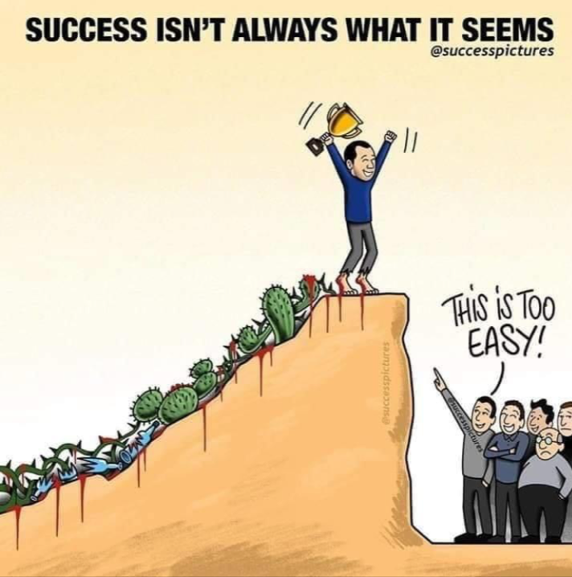


Lesson For Life

Slide 20
Thank you… Questions….??? If Any…

